Slide 1


NEX APP USER GUIDE
NX pre-sale
end to end
From finding the way in, to reading what this round offers, to entering the shares, submitting and tracking the allocation — eight steps through one round of the NX pre-sale, each one shot from the live screens.
Official site
n-exchange.io

Slide 2

NX pre-sale, end to end
OVERVIEW
NX pre-sale, end to end 3 stages · 8 steps
01
02
03
Stage one
Stage two
Stage three
Find the way in
Read the round
Subscribe and track
Discover · Nexus · Alpha
Identify NX · read the details · check price per unit
Enter shares · check the overview · wait for the allocation
Before you start
01
A registered NEX App account, signed in
02
Enough USDT in the account to cover the payment
03
An existing stake — how much you may subscribe is set by it
Official site n-exchange.io
02 / 16

Slide 3


Stage one
01
Stage one
Find the way in
Discover · Nexus · Alpha
2 steps
Official site n-exchange.io
03 / 16

Slide 4

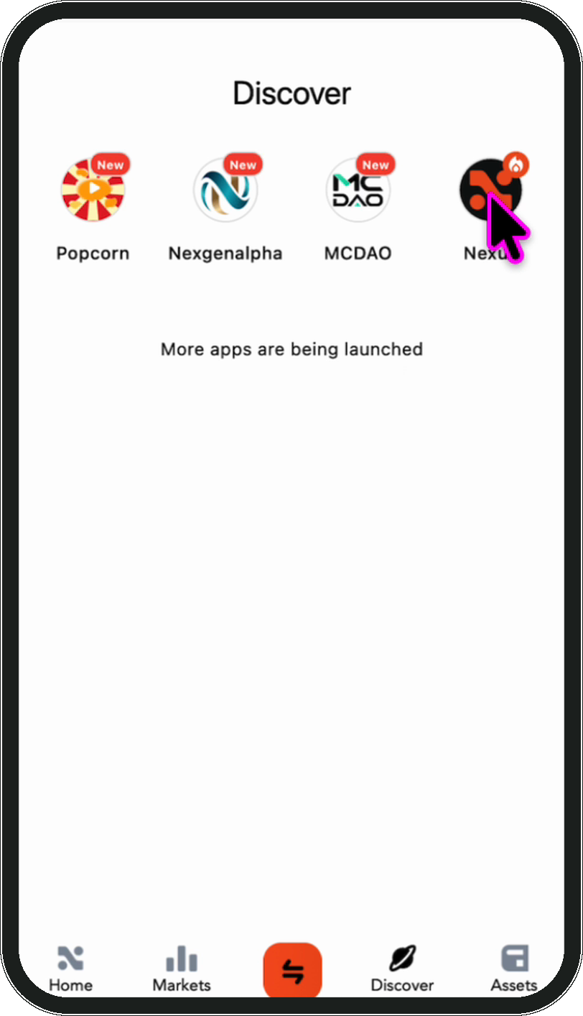
Stage one · Find the way in
01
Stage one · Find the way in
Step 1 of 2
1
Open Nexus from Discover
2
Open the NEX App and tap Discover in the bottom bar. This page lists the applications connected to the platform; find Nexus and tap it. The pre-sale lives inside Nexus.
1
Discover lists the connected applications
2
Tap Nexus to enter
3
Discover in the bottom bar
3
Tip A splash screen loads first. Let it through rather than tapping again.
Official site n-exchange.io
04 / 16

Slide 5
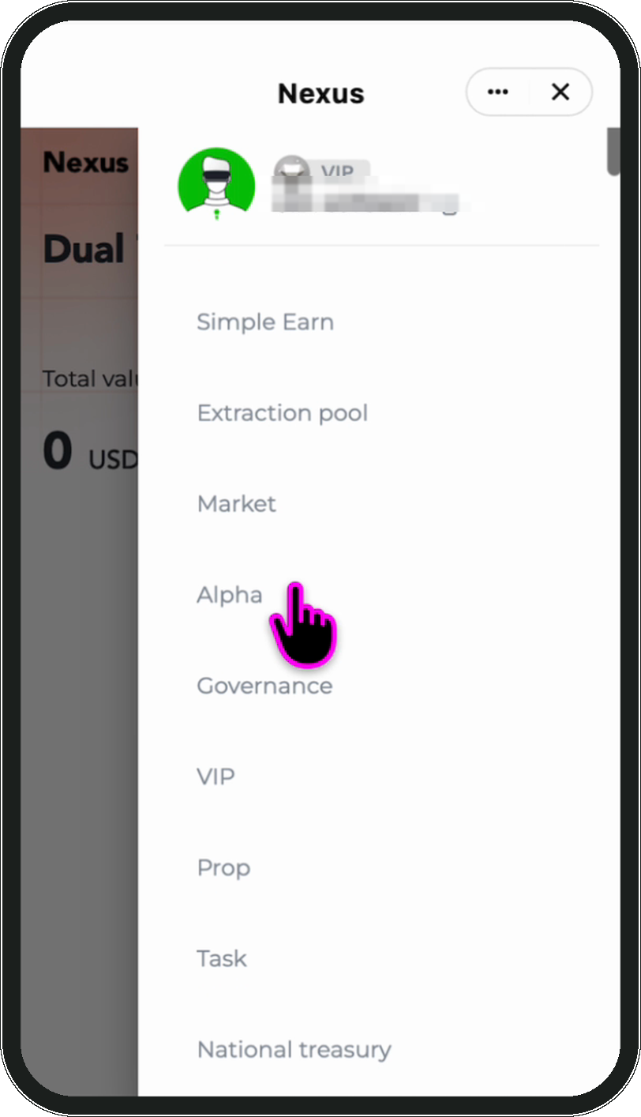
Stage one · Find the way in
02
Stage one · Find the way in
Step 2 of 2
Open the side menu and choose Alpha
Once inside Nexus, tap the top left to open the side menu. It holds every function Nexus offers; scroll down to **Alpha** — every offering sits in that section, and the pre-sale is reached from there.
1
2
3
1
The menu holds every Nexus function
2
Find Alpha and tap it
3
The other sections are not needed here
Tip The account shown at the top is the one you are signed in with — check it is the one you mean to use.
Official site n-exchange.io
05 / 16

Slide 6
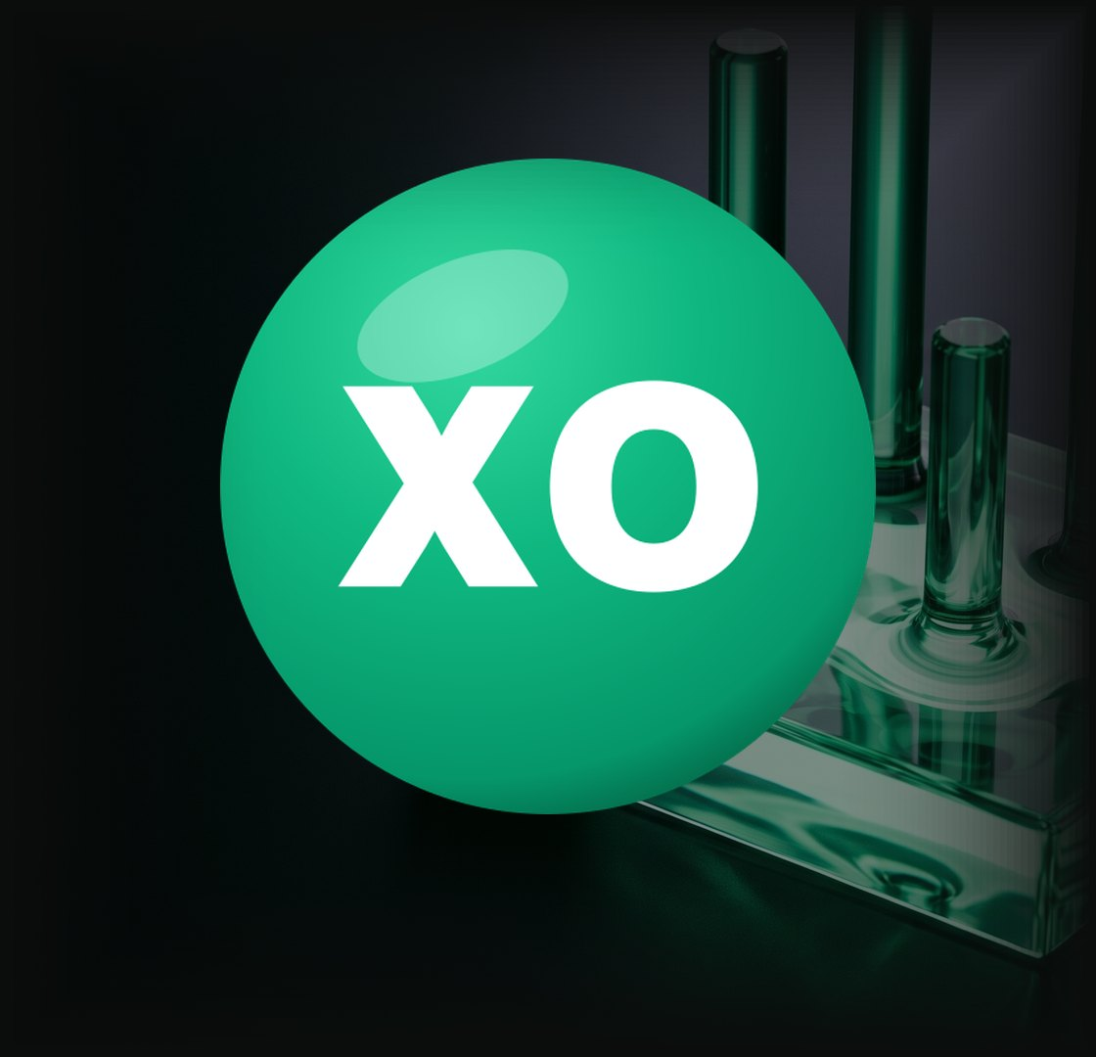
Stage two
02
Stage two
Read the round
Identify NX · read the details · check price per unit
3 steps
Official site n-exchange.io
06 / 16

Slide 7
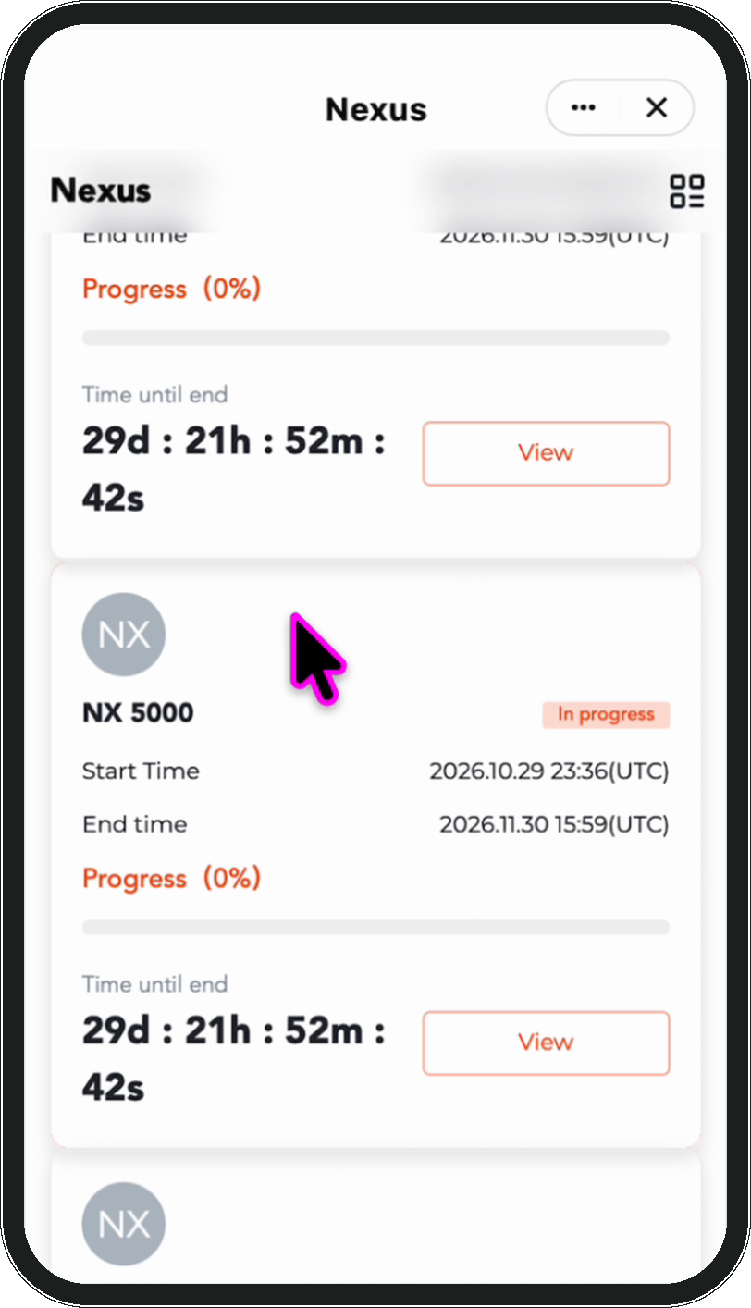
Stage two · Read the round
01
Stage two · Read the round
1
Step 1 of 3
Identify NX in the list
2
3
Alpha is split by status. Several offerings usually run at once, so **look for the entries named NX** — not the icon. Tap View to open one.
4
1
Split by status — start in 'In progress'
2
Look for the entries named NX
3
Start and end time
4
Tap View for the details
Official site n-exchange.io
Note Read the name, not the icon — several offerings run at once.
07 / 16

Slide 8
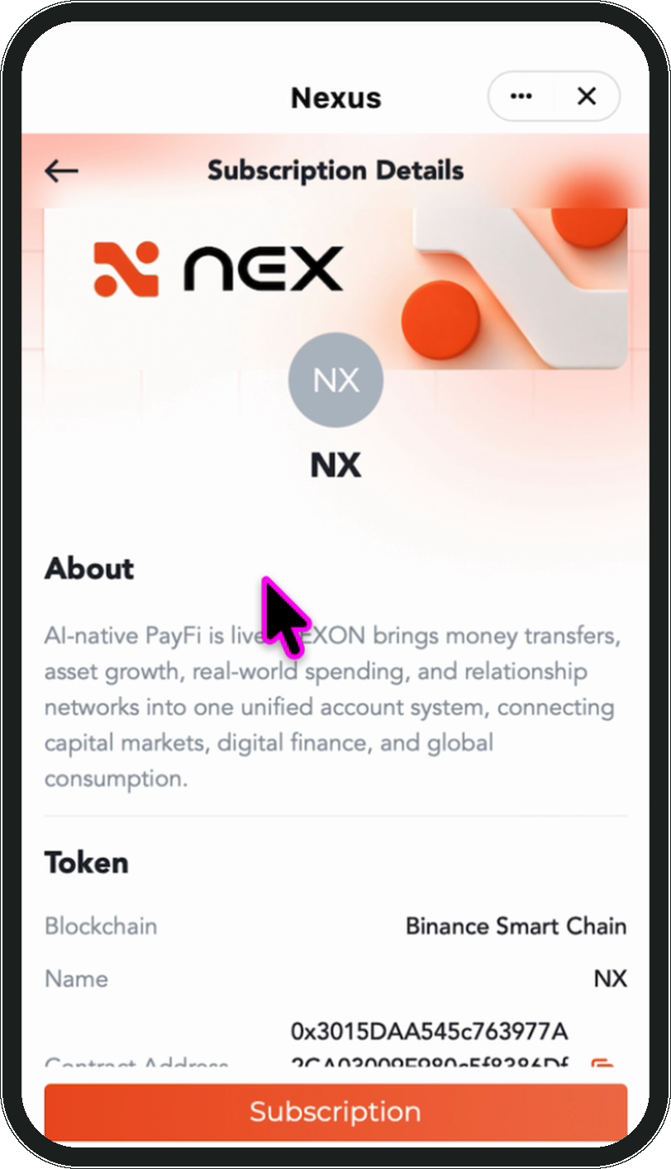
Stage two · Read the round
02
Stage two · Read the round
Step 2 of 3
Read About and Token first
The top of the page describes the project. Below it the Token section gives the blockchain, the name and the contract address, with a copy button beside it.
1
1
About — what the project does
2
2
Token — blockchain and name
3
3
Contract address, copy button on the right
4
4
Subscription sits at the bottom — not yet
Official site n-exchange.io
Tip Copy the contract address and check it on a block explorer.
08 / 16

Slide 9
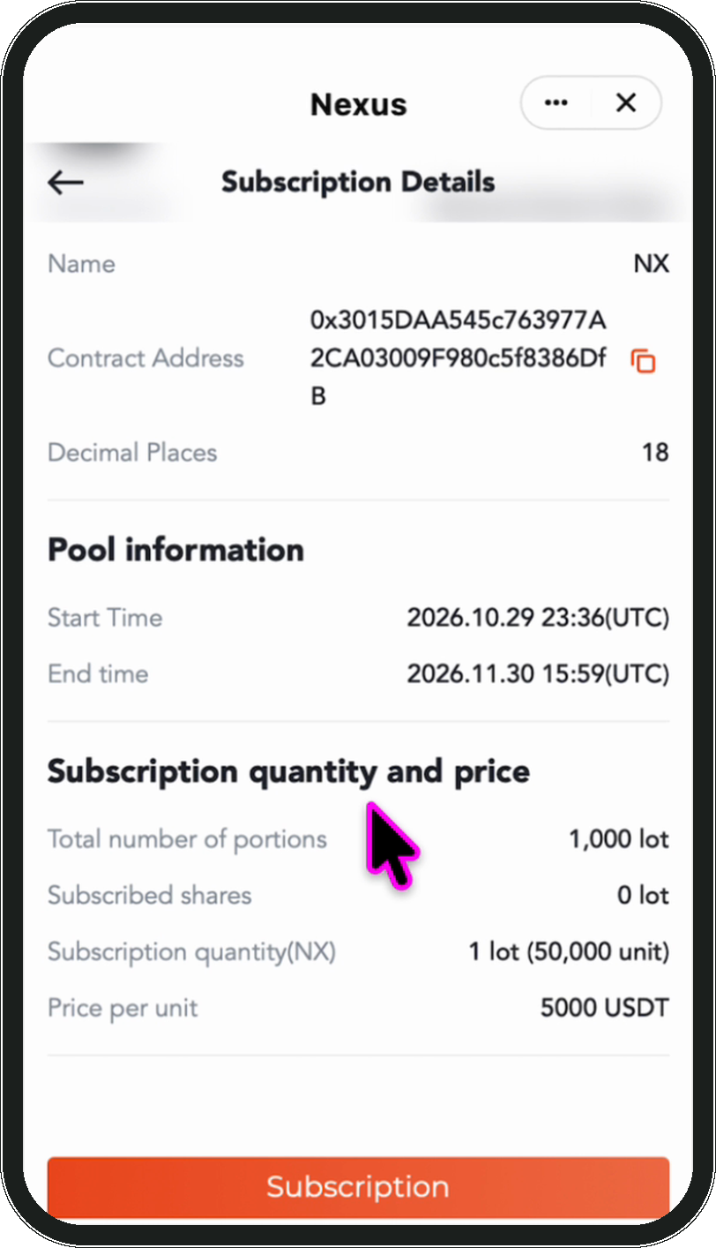
Stage two · Read the round
03
Stage two · Read the round
Step 3 of 3
Then Pool information and the price
1
Scroll on to these two sections. Pool information gives this round's start and end time; Subscription quantity and price gives the total number of portions, the shares already subscribed, the units in one lot and the price per unit. **These differ from round to round** — go by what the screen shows.
2
3
4
1
This round's start and end time
2
Total portions and shares already subscribed
3
Units in one lot
Official site n-exchange.io
4
Price per unit
09 / 16
Tip Subscribed shares moves while the round is open — refresh for the current figure.

Slide 10
Stage three
03
Stage three
Subscribe and track
Enter shares · check the overview · wait for the allocation
3 steps
Official site n-exchange.io
10 / 16

Slide 11
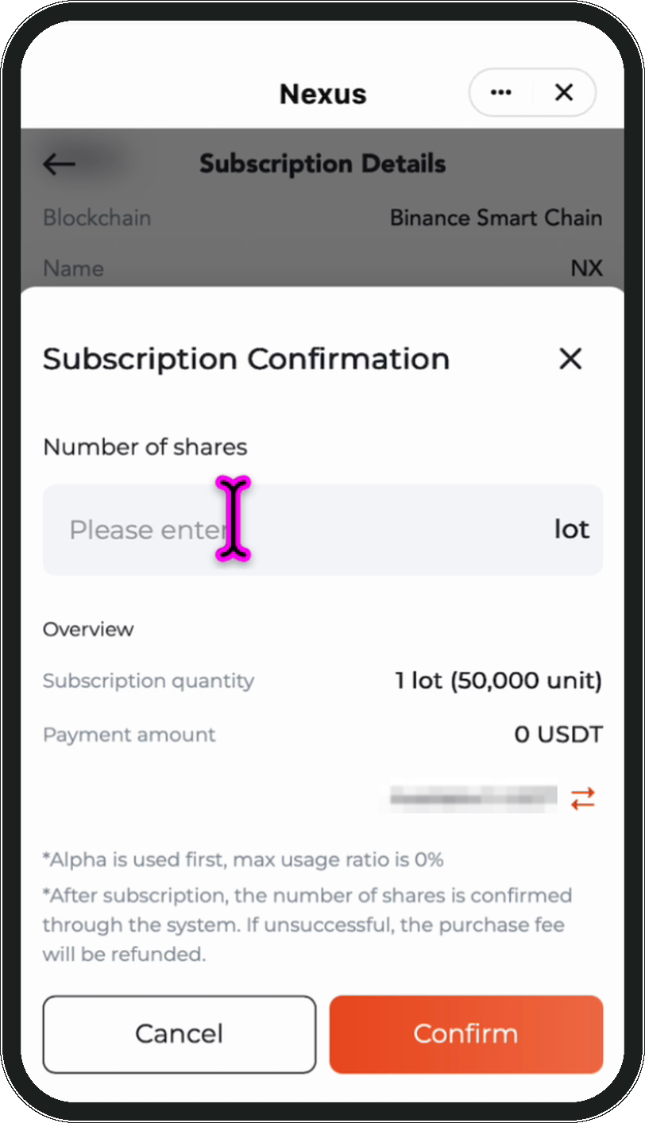
Stage three · Subscribe and track
01
Stage three · Subscribe and track
Step 1 of 3
1
Tap Subscription and enter the shares
Tap Subscription to open the confirmation box. Number of shares takes **lots, not an amount of money** — the Overview works out the rest.
2
3
4
1
Enter lots here, not an amount
2
Overview works out the quantity
3
Payment amount follows the number of lots
4
The line below is the available balance
Note The ceiling is set by your stake, not by your balance.
Official site n-exchange.io
11 / 16

Slide 12
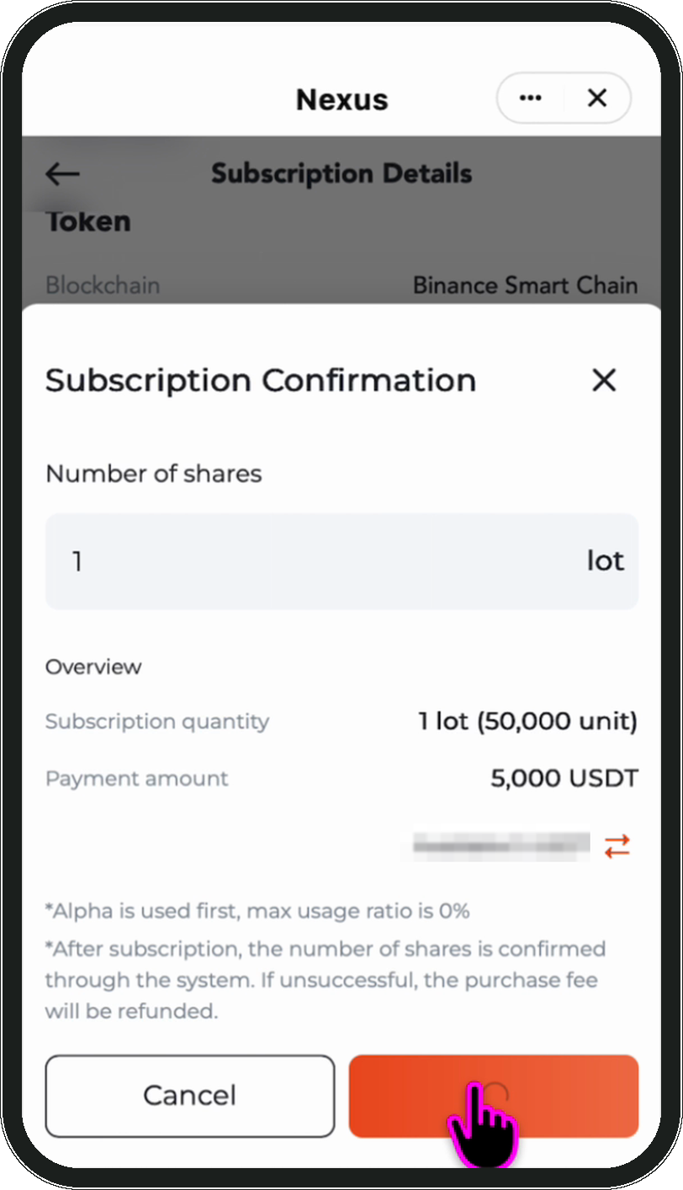
Stage three · Subscribe and track
02
Stage three · Subscribe and track
Step 2 of 3
Check the overview, read the fine print
Before confirming, read three things: the subscription quantity, the payment amount, and whether the available balance covers it. Read the two lines of fine print as well — they state the usage rule and that **shares are confirmed through the system, with the fee refunded if unsuccessful**.
1
2
3
4
1
Check the subscription quantity
2
Check the payment amount
3
The fine print: allocation and refund
Official site n-exchange.io
4
Confirm to submit
12 / 16
Note Confirming does not mean you have bought anything. This submits the subscription; the outcome comes from the allocation.

Slide 13
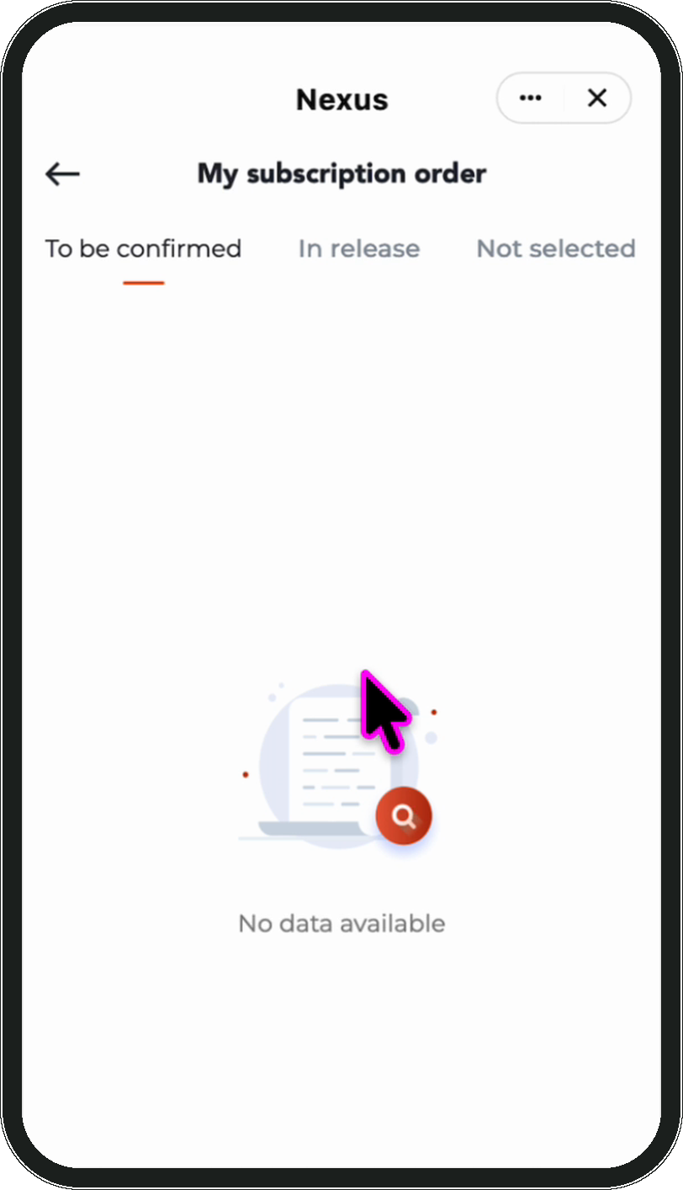
Stage three · Subscribe and track
03
Stage three · Subscribe and track
Step 3 of 3
1
Track it under My subscription order
2
3
4
Back on the Alpha page, tap My subscription in the top right. A new submission sits under To be confirmed until the allocation has run.
1
Orders split by status
2
A new submission starts here
3
Successful ones move to In release
4
Unsuccessful ones land here; the fee is refunded
Tip 'No data available' before the allocation has run is normal.
Official site n-exchange.io
13 / 16

Slide 14

BEFORE YOU CONFIRM
BEFORE YOU CONFIRM
Check each item before you confirm
01
Right section
Alpha is the one to open from the side menu
05
Within limits
Payment within the balance, lots within what the stake allows
02
Right offering
Entries named NX — read the name, not the icon
06
Fine print read
The allocation and the refund rule seen once
03
Details read
About, Token, Pool information and the price all seen
07
Order visible
The submission shows under My subscription order
04
Shares entered
Entered as lots; payment amount checked in the Overview
Official site n-exchange.io
14 / 16

Slide 15

QUESTIONS
QUESTIONS
NX pre-sale — common questions
01
I confirmed — why is it not bought yet?
A subscription is an entry, not a purchase. Shares are confirmed through the system, and the order stays under To be confirmed until that has run.
02
What happens to an unsuccessful subscription?
The fee is refunded. The fine print in the box and the Not selected tab on the order page describe the same thing.
03
Why will my number of shares not submit?
The ceiling is set by your stake. The page asks you to lower the amount or stake more. This is separate from your balance — a funded account can still be over the limit.
04
Are the price per unit and the units per lot fixed?
No. They differ from round to round and between tiers. Check the details page.
Official site n-exchange.io
15 / 16
05
Where do I see what I subscribed to?
My subscription, top right of the Alpha page. Orders are split into To be confirmed, In release and Not selected.

Slide 16


NEX APP USER GUIDE
All Done
Every step is done, from finding the way in to submitting. The allocation result appears on the order page.
Official site
n-exchange.io
16 / 16

